Slide 1
SKOA – Story Overview
A very rough overview

Slide 2
Background
Very long ago

Slide 3
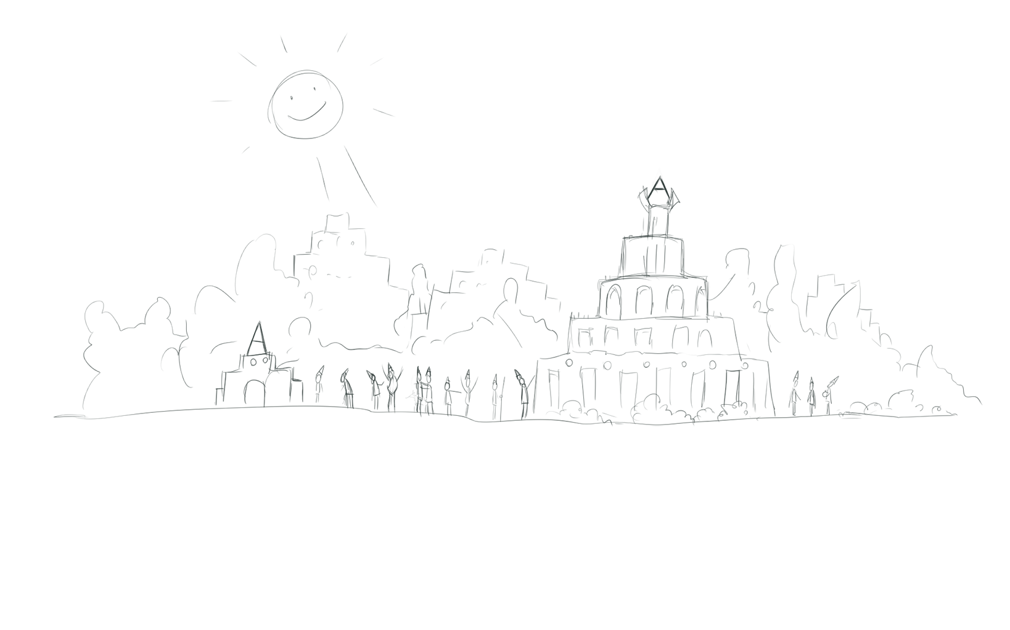
The Angorian Civilization was at the peak of its Golden Age…

Slide 4
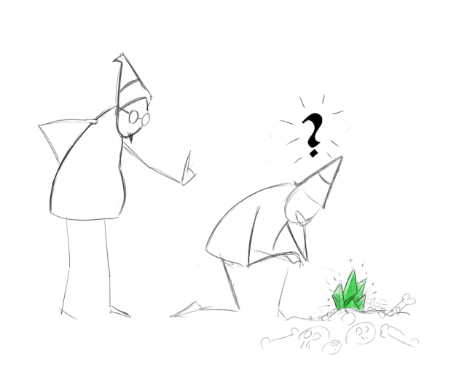
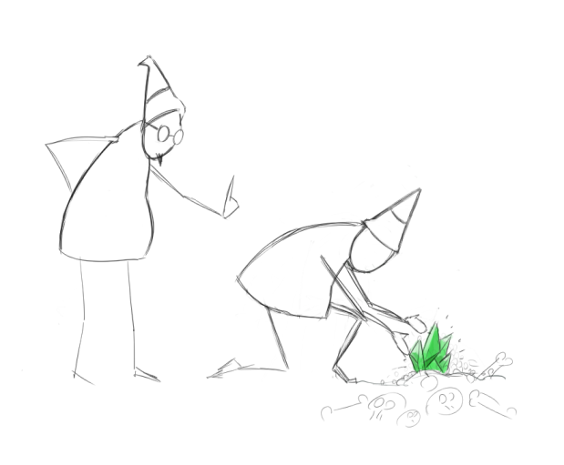
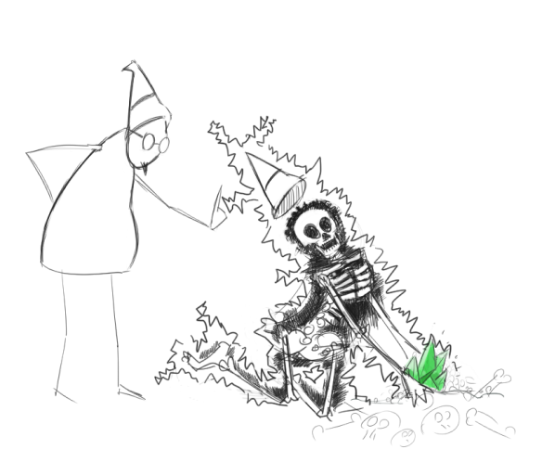
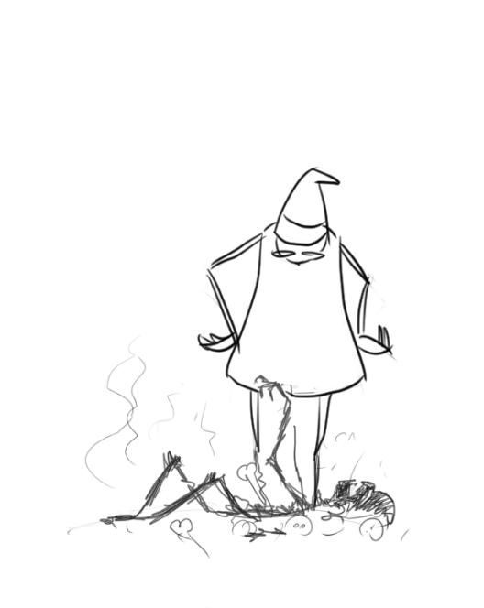
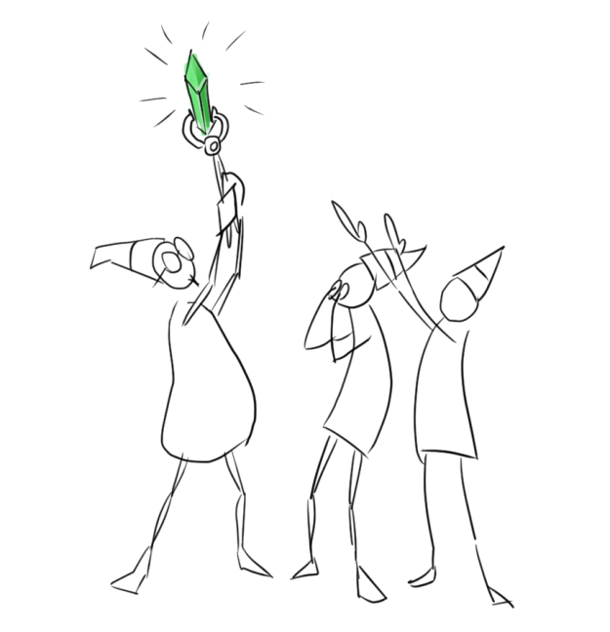
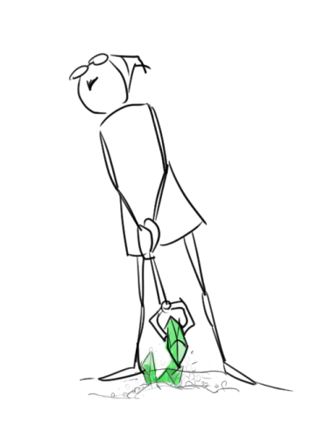
But the discovery of THE ESSENCE ushered in a new era!

Slide 5
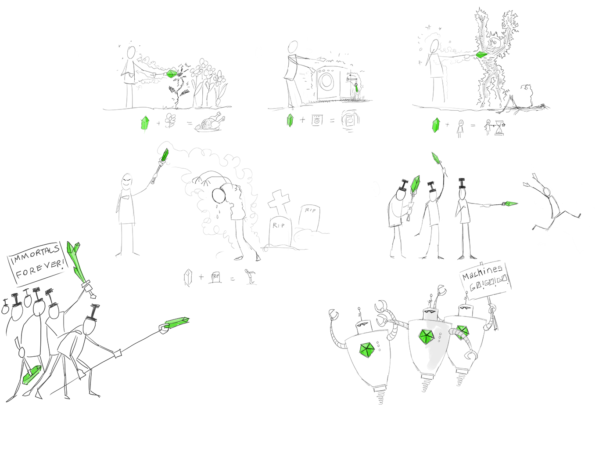
Essence is LIFE and the Angorians found a way to transfer it. First they started stealing life from plants which made them fulfilled and not hungry, and they put stolen life into machines to make them work. But then more sinister uses appeared: if you steal life from an Angorian it prolongs your life, and if you put essence into a dead thing, it rises from the grave.

Slide 6
There was also a catch to stealing essence that they did not realize: the process has a lingering side effect, a radiation that the world will know as the Black Plague.

Slide 7
The use of essence divided the Angorians:
The MACHINISTS did not want to kill each other for life. They just wanted to build machines.
The IMMORTALS only wanted life, lots of life. They thought the sacrifice of many should elevate the worthy few.
Civil war broke out…

Slide 8
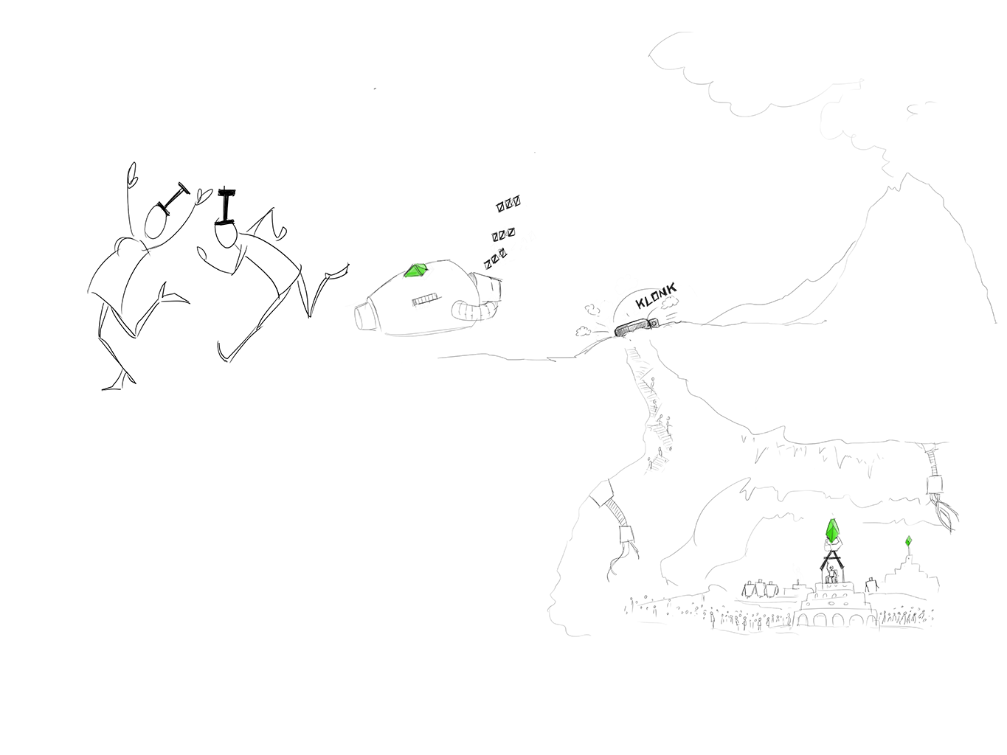
As the fight raged on the Machinists thought they cannot survive against the life stealing Immortals, so they devised a final plan. They built machines, Mechanical Golems that also steal life, but only from Immortals. They unleashed an army of Golems and they fled from this apocalypse into the Underground World, never to be seen or heard of again.

Slide 9
The battle on the surface destroyed everything the Angorians built during the centuries, leaving only ruins. Machines and Immortal were dying in equal measure. Packages of essence and radiation marked the places where they died.
When the last Mechanical Golem ran out of energy, only two immortals remained. They decided to hide and pursue new plans, using the essence and its radiation for a twisted vision that will be known as the Dark Cult.

Slide 10
Background
Not so long ago

Slide 11
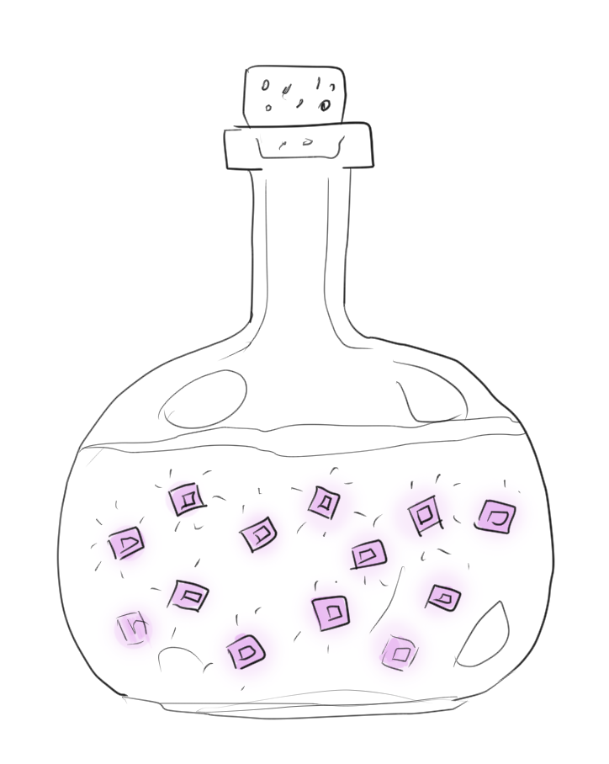
Penerelle, alchemist of the High King obtains a package of ESSENCE

Slide 12
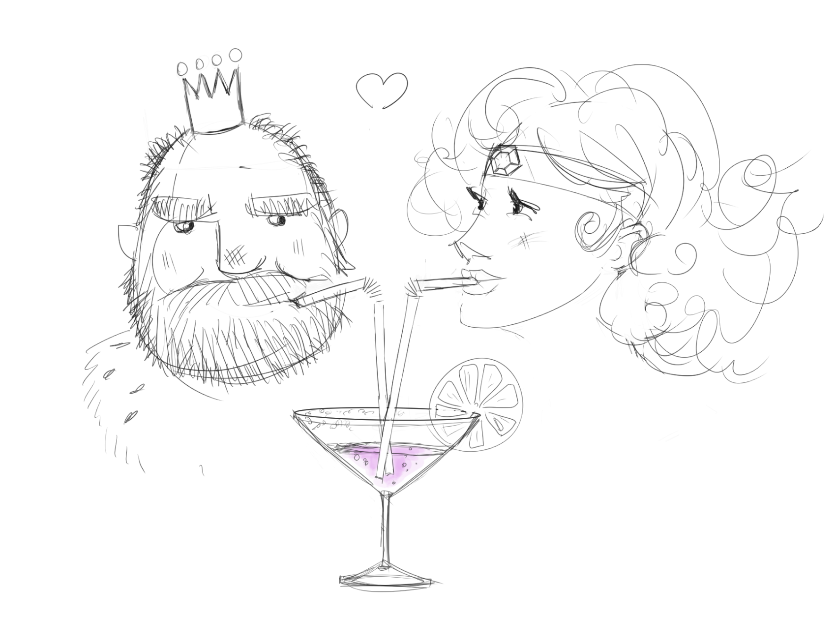
Penerelle and the King are strongly connected. They share a vision of a wealthy kingdom - rich economically and intellectually. Their immortality would give them enough time to see their vision come true, so they shared the package of ESSENCE…

Slide 13
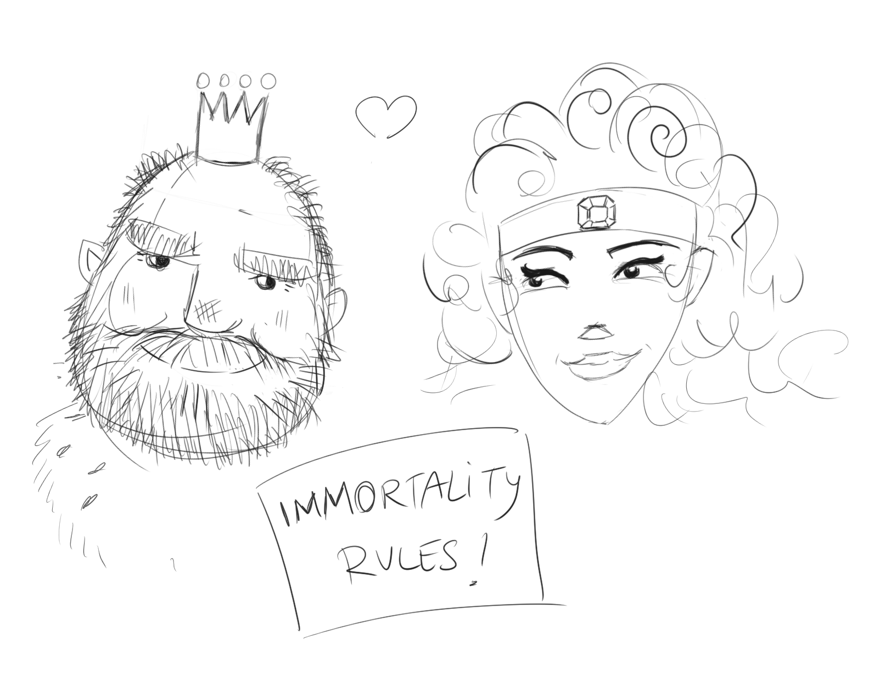
… and are now “limited” immortals.

Slide 14
Background
Game start

Slide 15
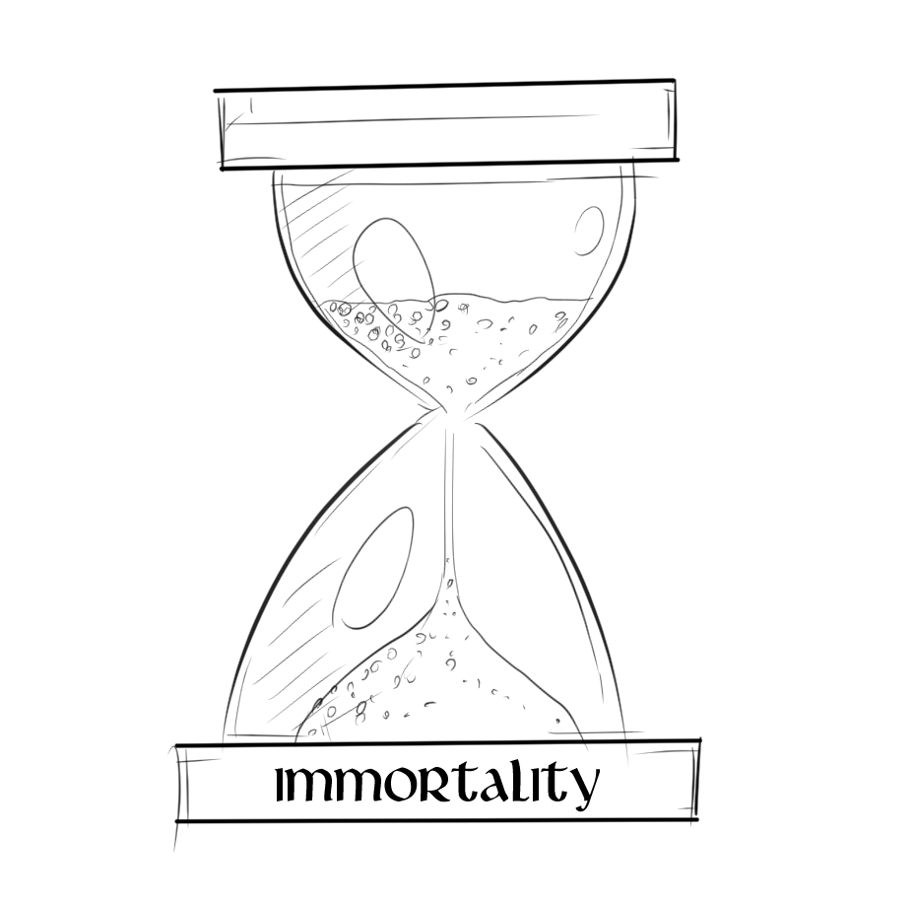
Penerelle and the King feel that the power of the ESSENCE is fading away. They need another Shot, so Penerelle returns to the Untamed lands

Slide 16
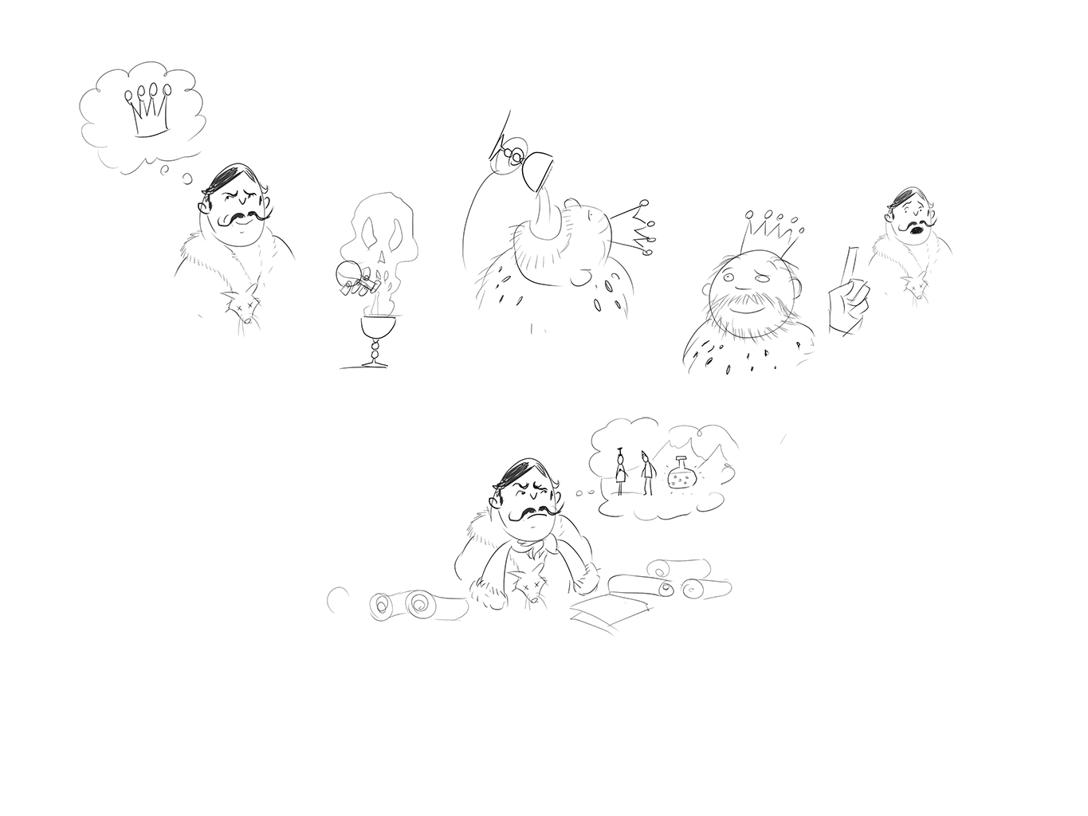
A nobleman called the Old Lord would be the next King, if the current one would pass away. He did EVERYTHING to bring most of the High King’s Council to his side.
At one point he decided to kill the KING. The Assassination was perfectly executed, BUT the King didn´t die and even did not suffer a second. This led to a thorough investigation by the Old Lord. The clues guided him towards the untamed lands…

Slide 17
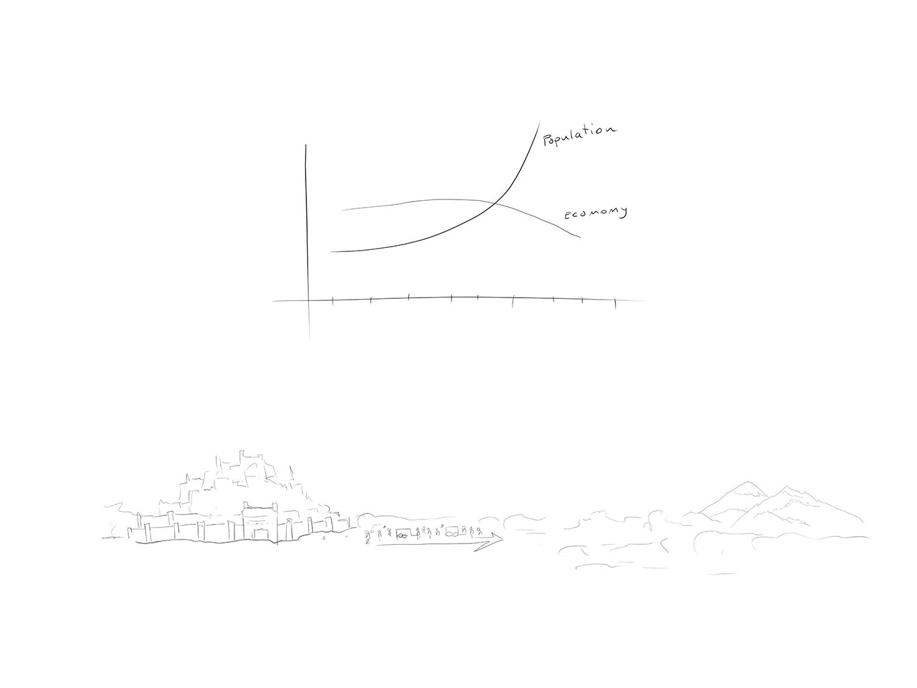
Economical high times led to a huge growth of the High Kingdom Population leading now to shortage in lots of areas, so the King promises everyone a prosperous future who colonizes the untamed lands for the High King.
The PLAYER goes to the Untamed lands…

Slide 18
Story Flow
T1 to T6

Slide 19
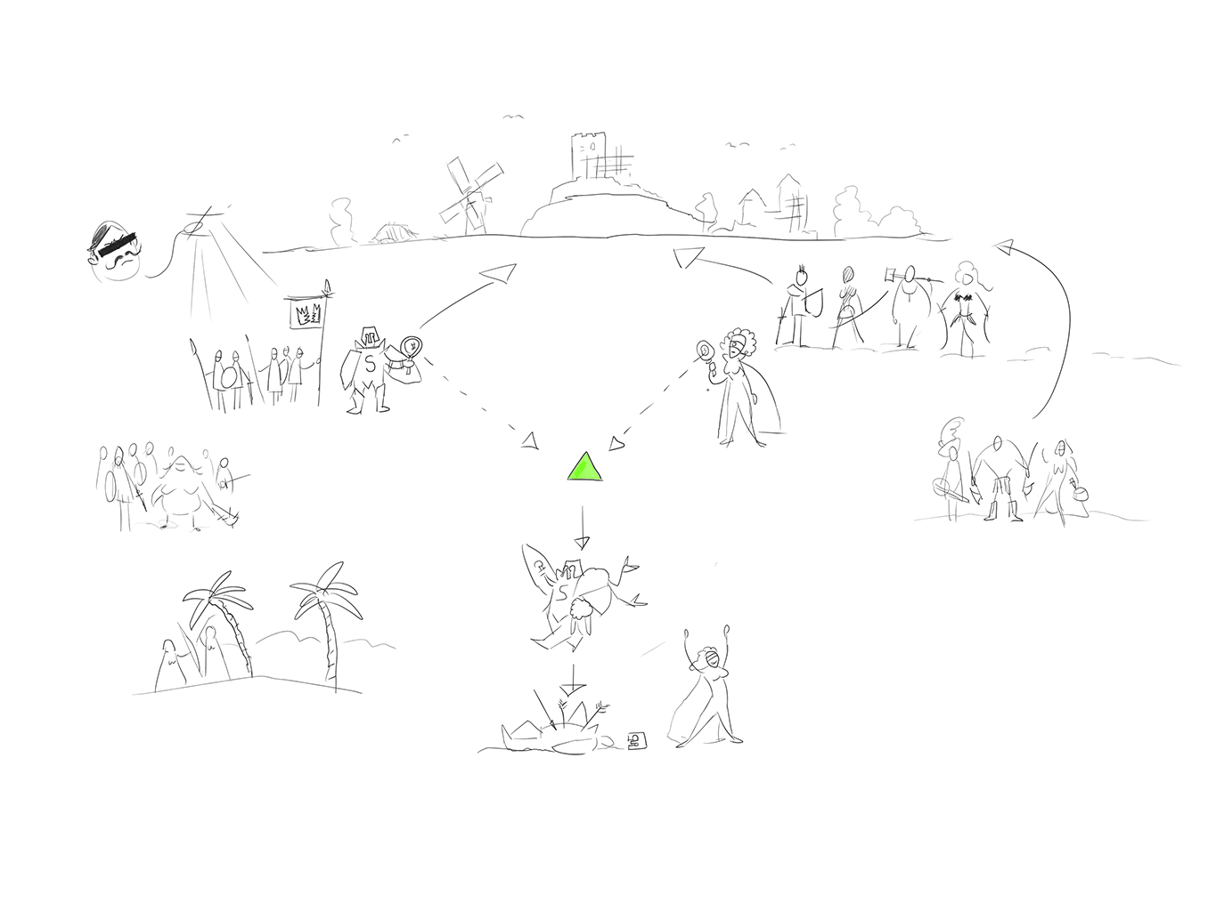
T 1 - The Player arrives in the untamed land. The Player’s goal is to escape a boring life of insignificance and poverty. In the untamed land he has the chance to become famous, rich and live a self-determined life. In the untamed lands he finds new friends [Champions] and new enemies.
The Broken Crown is searching for mysterious artefacts and will do everything to get them. It seems that they get their order from someone outside of the untamed lands. As we get hold of two of these artefacts, they try to steal them from us. Which leads us to kill one of their commanders - STARVARD (Boss of T1)

Slide 20
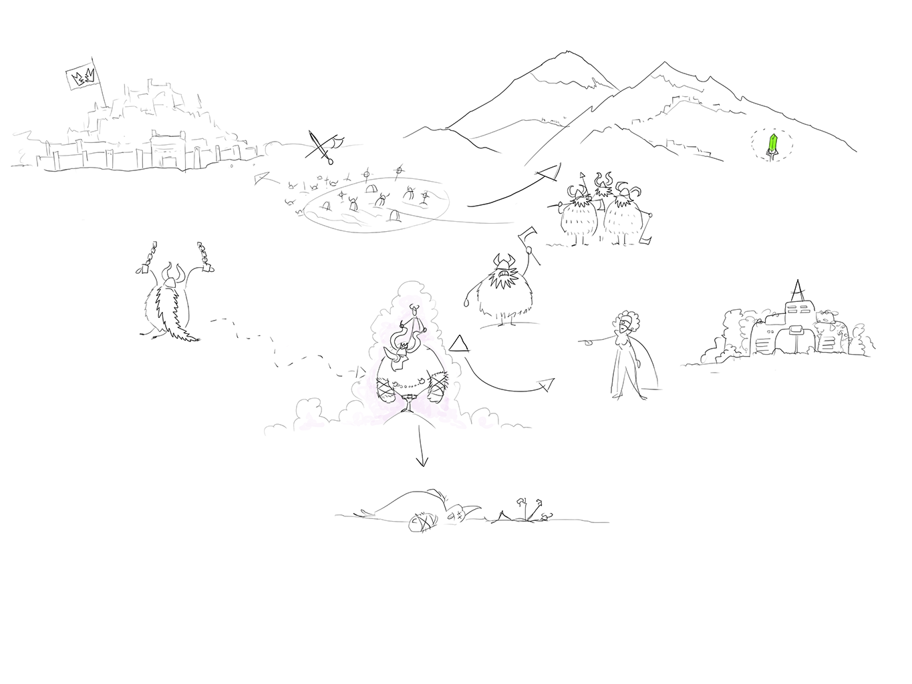
T 2 - The Frostbeards were a strong civilization ruling over the untamed lands for decades. But as Leir the Rampant led the Frostbeards into an all or nothing Battle against the High Kingdom, the Frostbeards were nearly annihilated.
The Frostbeards fell back to the Mountains in the northern parts of the untamed lands. In the past few years they started to regain their strength, but the source of this strength lies in mystery...

Slide 21
Penerelle pushes us to get more mysterious items, before the Broken Crown Army would get them, and it seems the Frostbeards know more about this. The Frostbeards see us as invaders and haven’t forgotten about the last Battle we fought with them.
To not fight our way through the whole Frostbeard civilization we are looking for help from a Frostbeard insider to get close to the Frostbeard King. As we finally approach the Frostbeard King we see a mutated creature which has nothing to do with the Frostbeard King which was described to us. Before we can say a thing, we are fighting for our lives.

Slide 22
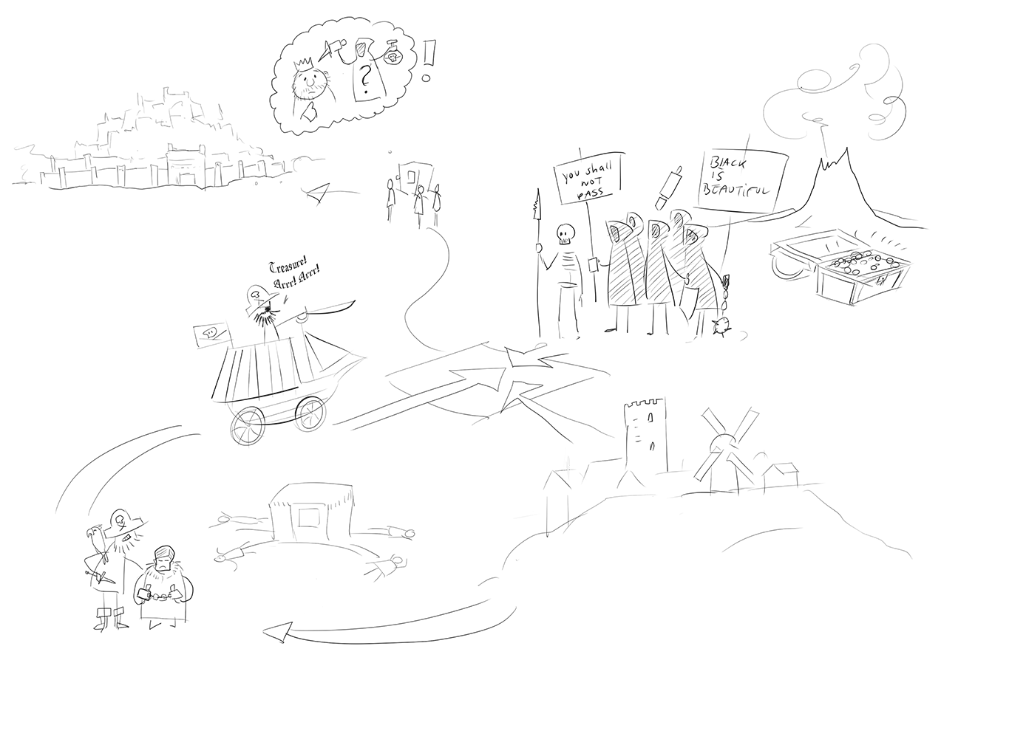
T 3 - Pirates are looking for treasure! According to an old legend the world’s greatest treasure lays hidden deep inside a mountain somewhere in the untamed lands. The Pirates have been travelling towards this place for years, but as they now reach our territory they encounter an obstacle they cannot overcome so easily. The Dark Cult stands between them and the Mountain.
Between these two powers lay our access to the High Kingdom.

Slide 23
We discover that the Broken Crown is controlled by someone from the High King´s Council (so the inner circle of the King).We want to warn the King that there might be a problem.
The Envoy who is sent to tell the King is captured by the Pirates before he gets there. And as we try to drive the Pirates off the Dark Cult enters the scene...

Slide 24
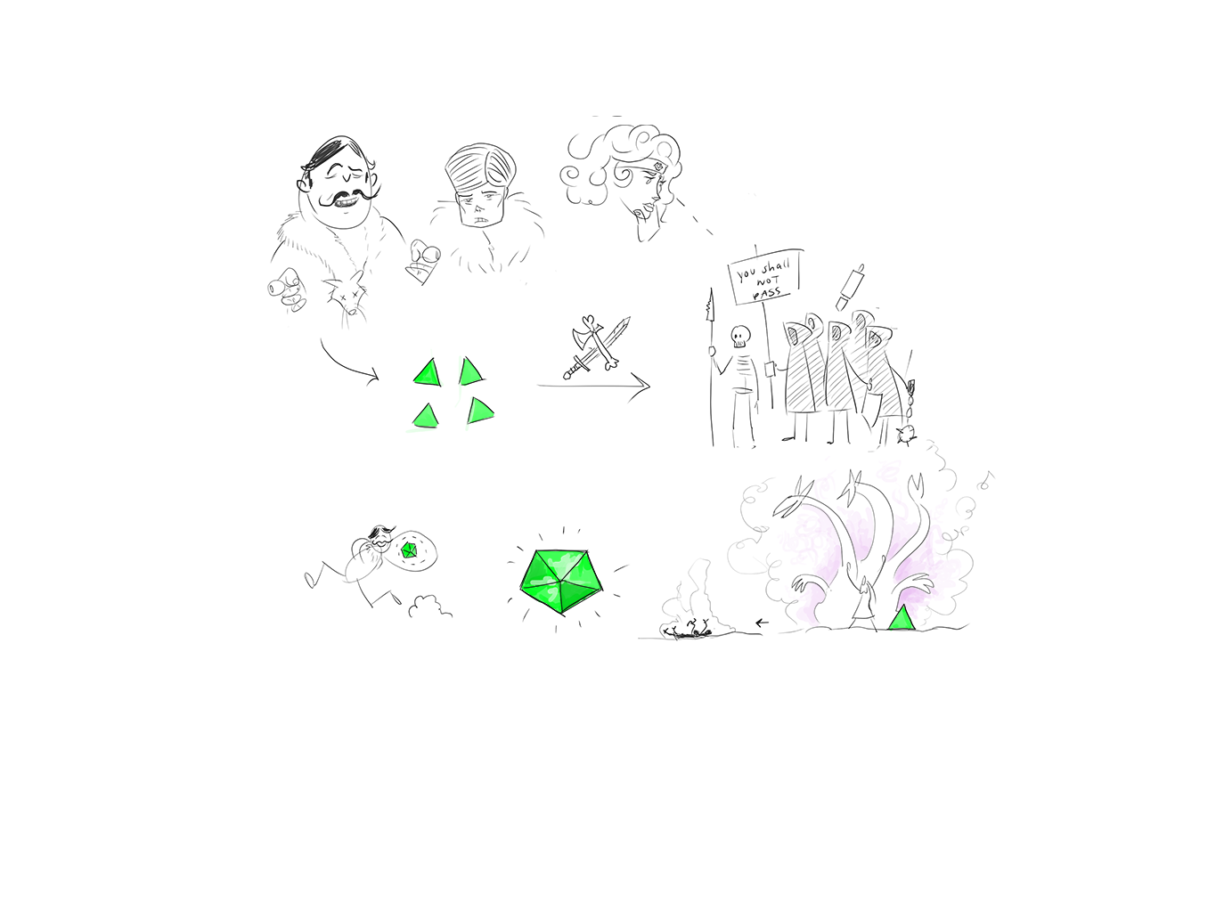
T 4 The Envoy returns and brings someone with him - the Old Lord. In the name of the King he thanks us effusively.
He is very interested in the Keys. Penerelle and the Old Lord pushes us to investigate this Dark Cult stuff deeper.
Our Scout mission confirms to us that the Dark Cult has a Key, too. And this would be the last Key we need.
Even though we managed to get this information, our Scout mission did not go too well and some of the Scouts were captured.

Slide 25
Because of them the Dark Cult knows that we have 4 Keys. They also want to have them so they launch an attack. A patrol we send out discovers a vanguard of the Dark Cult heading towards us. The patrol has to defend itself till reinforcements arrive. For now we fought back the Dark Cult, but the main force is approaching fast. We have to set up defenses. As the main force of the Dark Cult arrives we are in deep trouble. In the end we survive, and manage to weaken the Dark Cult. Now we can advance to the heart of the dark cult and face their leader to snatch the last key from her.

Slide 26
As soon as we have the last key, the Old Lord shows his true colours. He grabs the Keys and disappears. He is now searching for the Vault.
At this point we are quite sure that the Old Lord is the traitor in the High King’s Council.

Slide 27
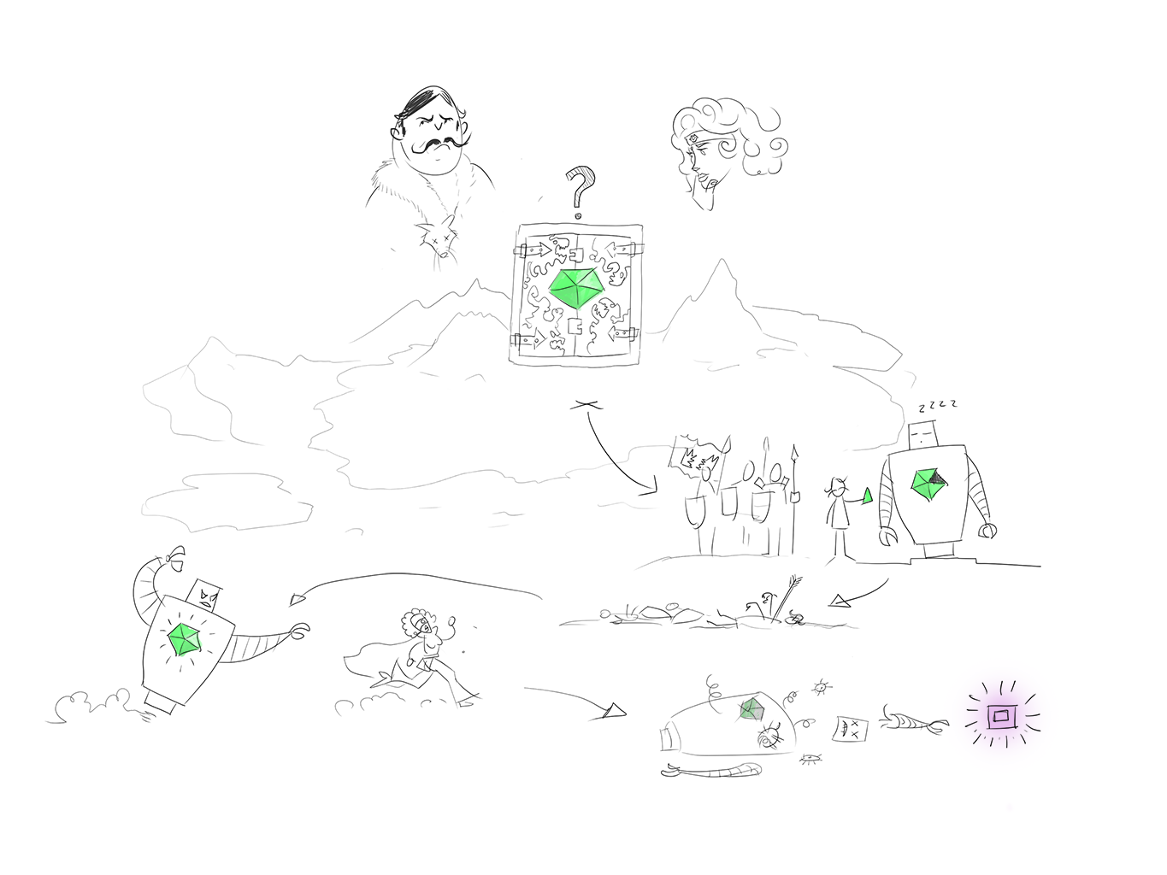
T 5 - The important Question is: Where is the Vault? What we know is that the Old Lord is also looking for it. We still do not know, what exactly awaits us at the Vault, but Penerelle stresses that we have to be there first.
Finally we find the Vault. Or what we think the Vault is. We meet the Old Lord adding 4th key into a statue. Of course we kill the Old Lord.
After that we put the 5th key into the statue. The Statue comes alive and wants to kill Penerelle. So we kill it, too. In his last moment he releases a small package of Essence. Penerelle takes it.

Slide 28
?
T 6 – Totally random procedual generated story awesomeness

